Slide 1
Time to Focus:
Doing Things Better and Differently for Transgender People
Rena Janamnuaysook
Thai Red Cross AIDS Research Centre, USAID LINKAGES, Thailand
July 23, 2018
Disclaimer: This presentation is the Intellectual Property of Thai Red Cross AIDS Research Centre. It is intended for the use of meetings only.
No part of this presentation may be reproduced, republished, distributed, displayed, transmitted or otherwise exploited in any form
or by any means, electronic or mechanical, including photocopying, recording, or any information storage and retrieval system,
without the prior direct permission in writing from Thai Red Cross AIDS Research Centre."

Slide 2
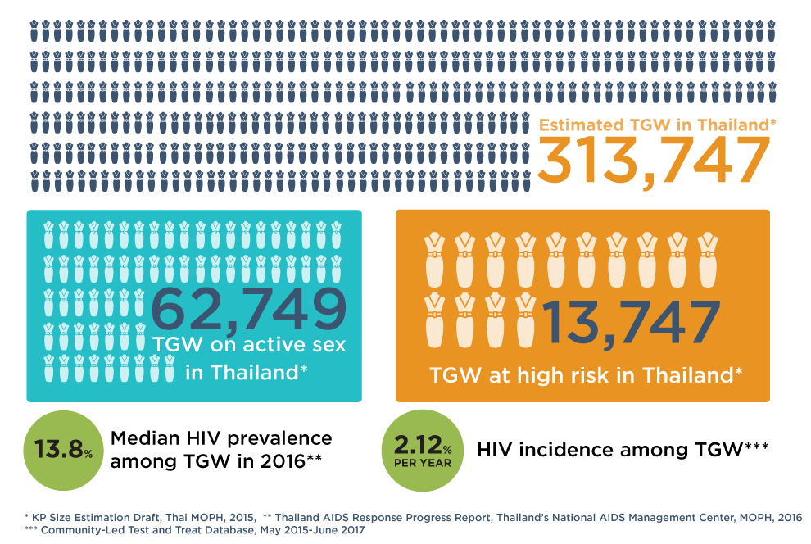
Transgender Women in Thailand:
Population Size Estimation and HIV

Slide 3
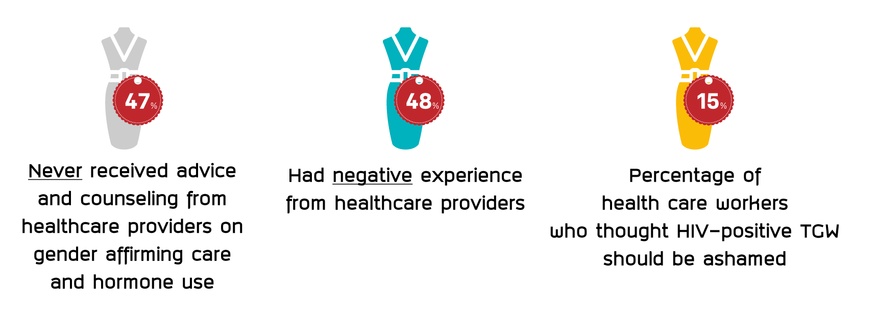
Stigma and Discrimination in Healthcare Settings
**
**
*
Sources:
*Thai Transgender Alliance and Transgender Europe, 2015
** Report of a pilot: Developing Tools and Methods to Measure HIV-related Stigma and Discrimination in Health Care Settings in Thailand and;
the HIV Stigma and Discrimination Survey Guidelines and Procedures Manual, International Health Policy Program, National AIDS Management Center (NAMC) Thailand,
Ministry of Public Health (November 2014).

Slide 4

The 1st National Trans Community Consultation
The Dialogue: Trans Communities and Health Provider
September 17, 2015

Slide 5
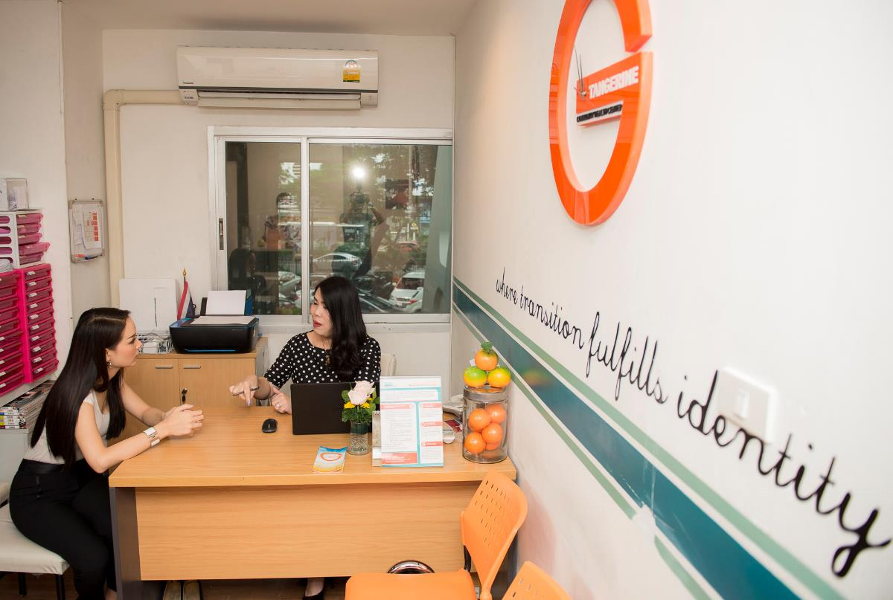
Tangerine Community Health Center:
Trans-led, hormone-integrated and sexual health services

Slide 6

The Comprehensive Health Service Package for Transgender Women
HORMONE SERVICES
SEXUAL HEALTH SERVICES
Counseling on gender transition
Hormone prescription
Hormone level monitoring
HIV testing, syphilis testing
Condom and lubricant
Anal and neovaginal Pap smears
High Resolution Anoscopy and Neovaginoscopy
PrEP and PEP
Same-day ARV treatment, CD4 count and viral load testing
STI treatment
Vaccination for hepatitis A, B and HPV
WELL-BELING SERVICES
Mental health support and referrals
Referrals for gender affirming surgery
Referrals for legal services
Botox & skin care

Slide 7
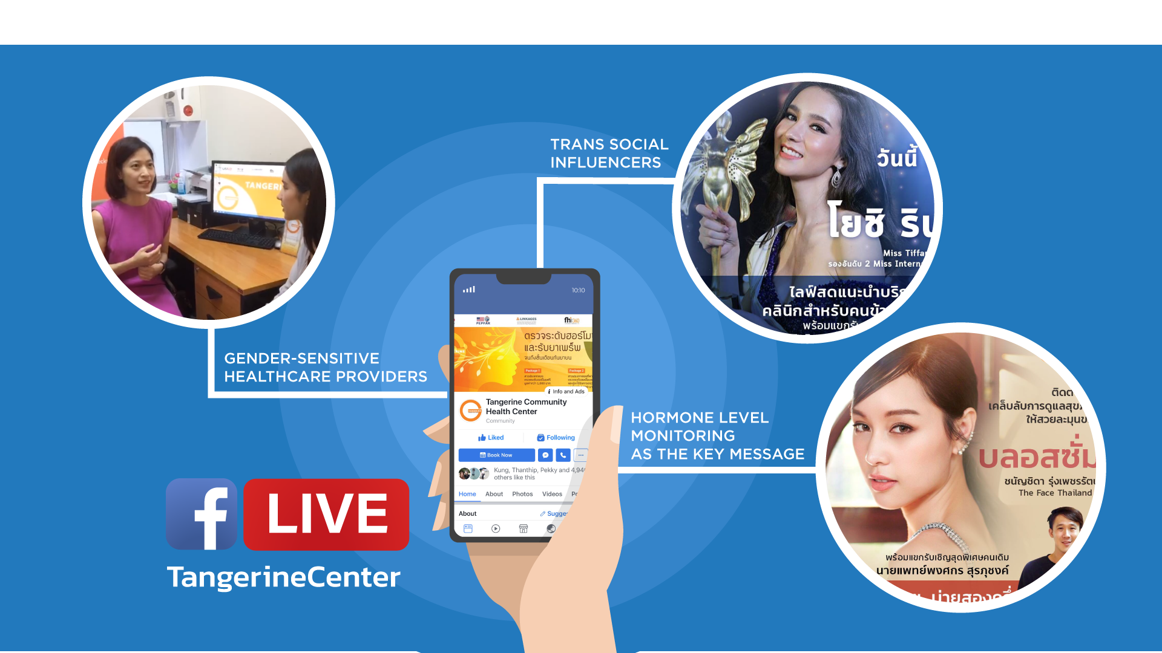
Online Outreach Strategies

Slide 8






Slide 9
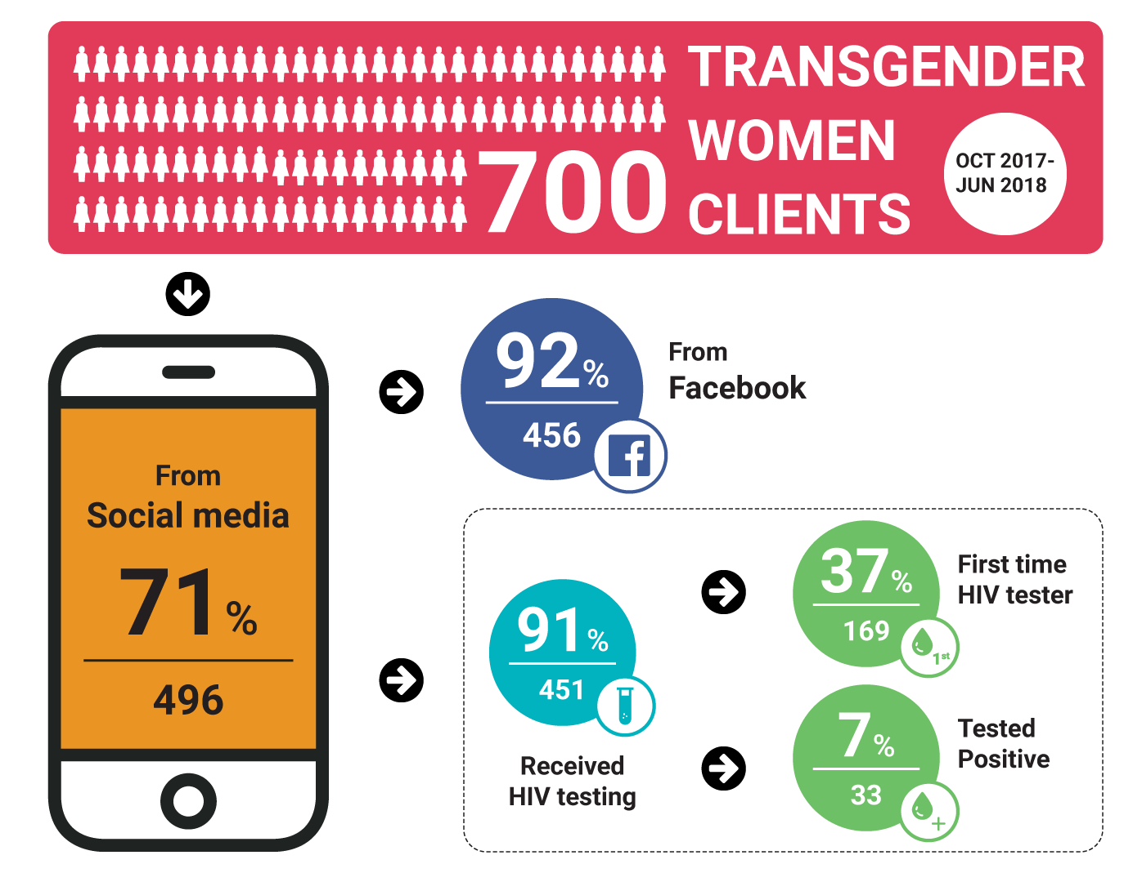
Online Outreach Performance

Slide 10
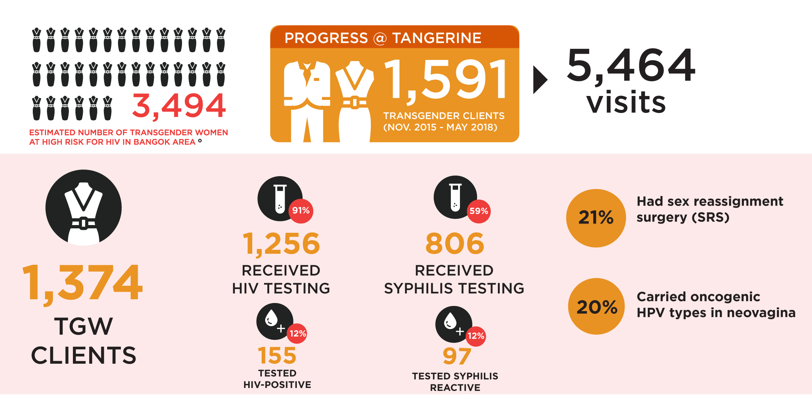
Progress to Date (as of May, 2018)

Slide 11
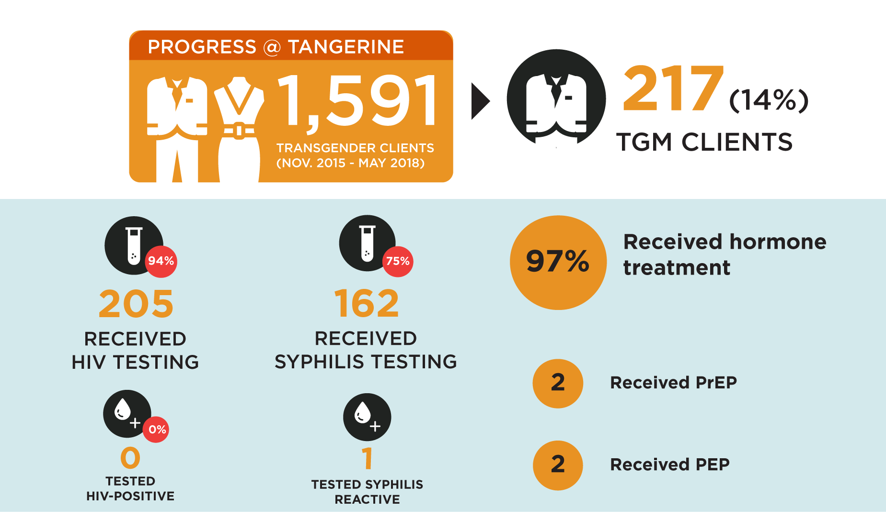
Transgender Men (TGM)

Slide 12
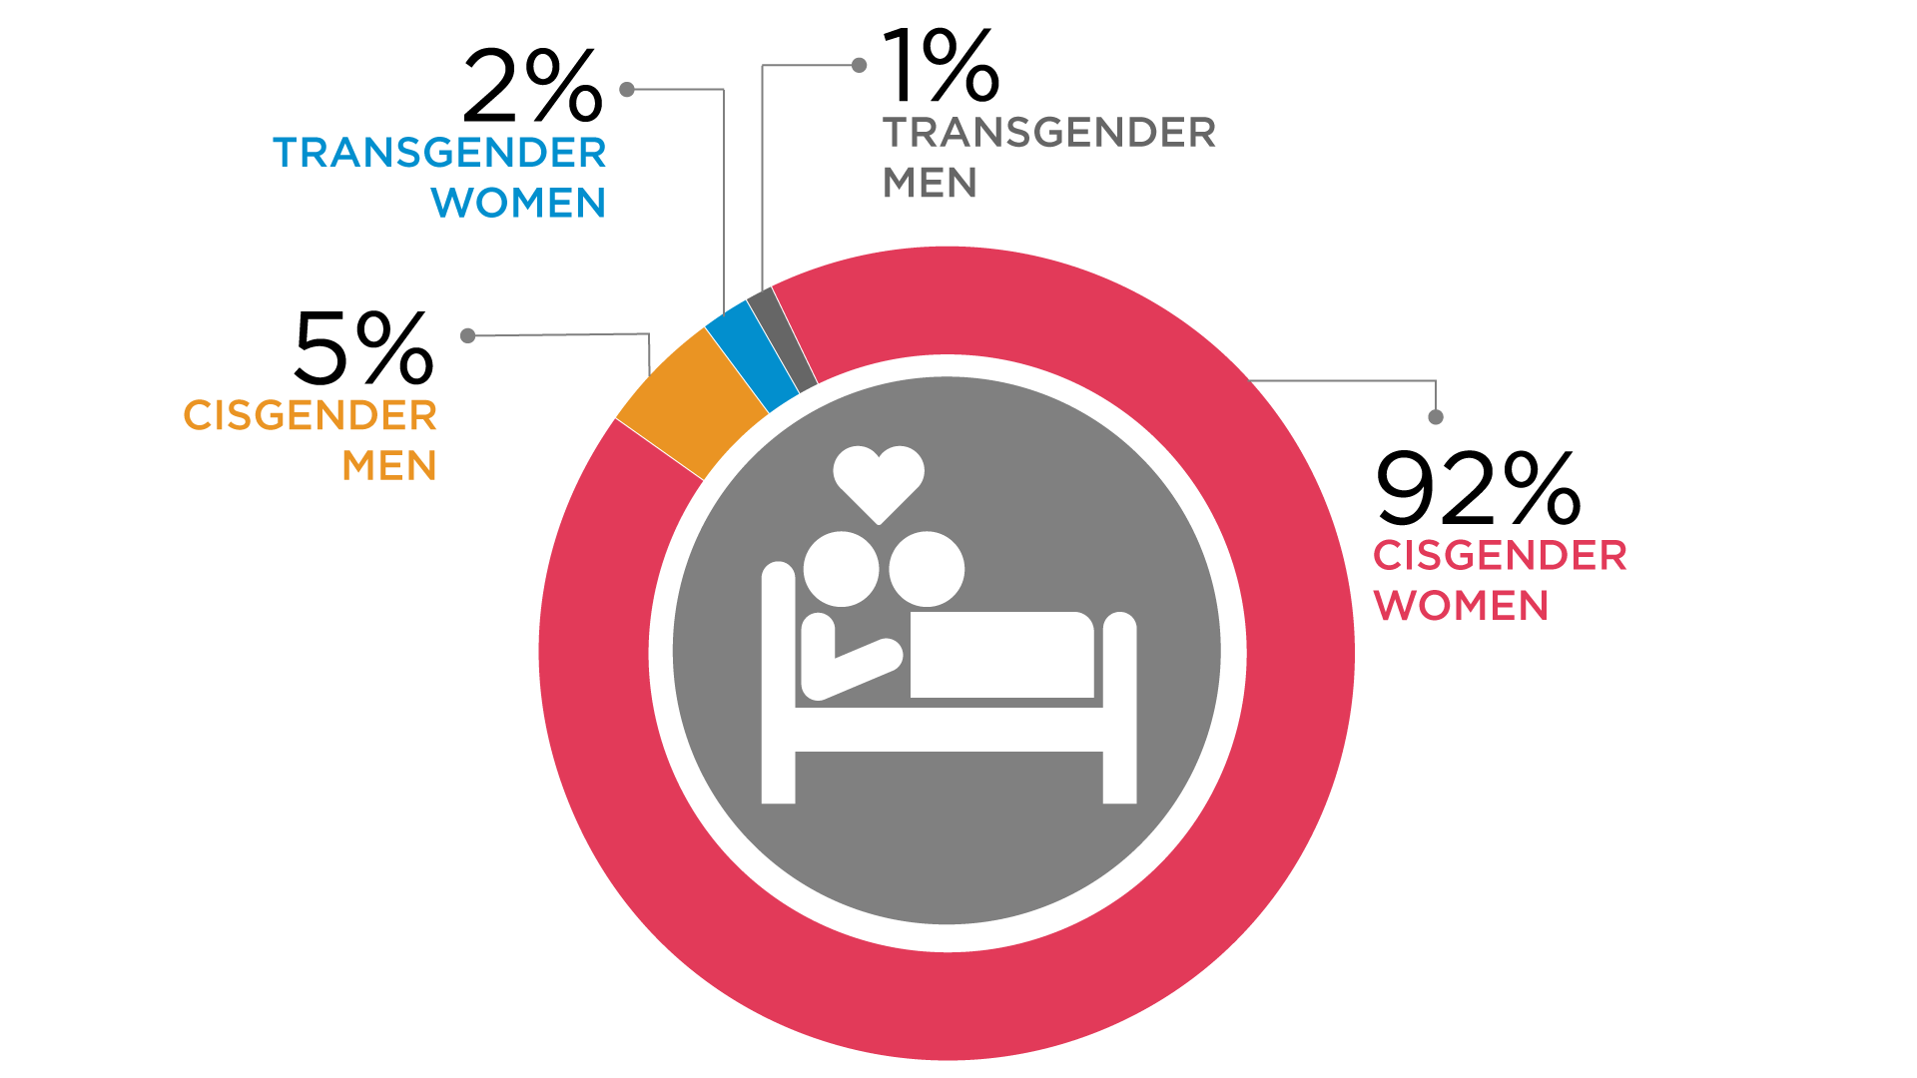
Sexual Behaviors among Transgender Men (n=141)

Slide 13
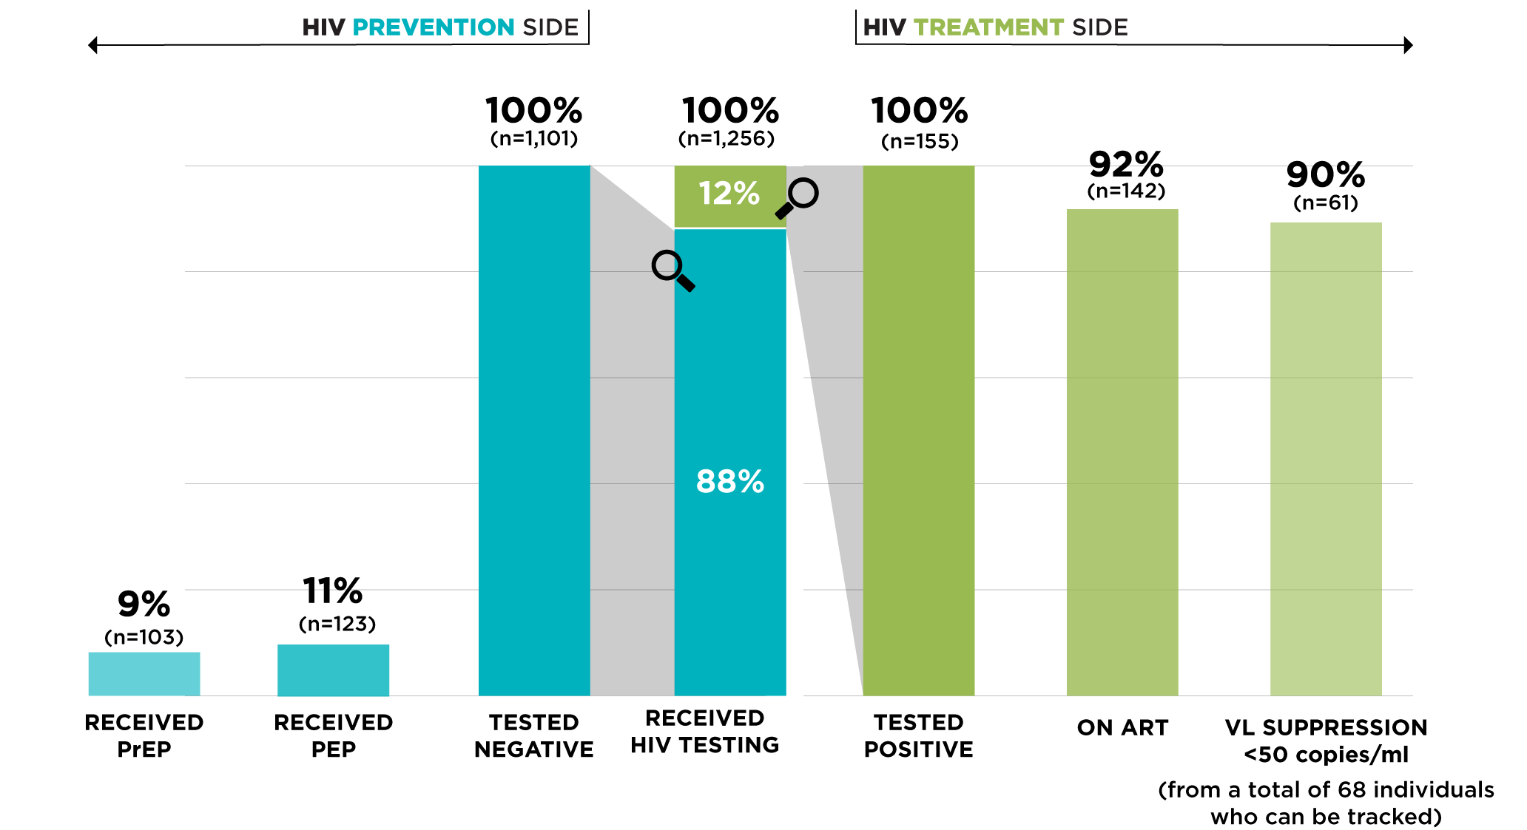
The Double-sided HIV Cascade Performance

Slide 14
Tangerine Story:
A survivor from sexual abuse
Young trans woman, aged 14, visited Tangerine with her mother
Learned Tangerine from her trans icon through social media
Hormone was her primary purpose
Sexually abused by a school senior
Accepted HIV testing offered by trans counselor
Tested HIV-positive and successfully initiated same-day ART
Referred to HIV pediatrician
Her mother supporting her gender transition and treatment adherence

Slide 15
Challenges
Low PrEP uptake and no city-wide targeted campaign on PrEP and TGW
Limited reach to subgroups: young TGW, TGW sex workers, TGM who have sex with men
Low HIV testing uptake among male partners of TGW
Inadequate psychosocial support and mental health counseling
Low median CD4 counts at diagnosis: 304 (IQR: 230-405) cells/mm³
Hormone services not supported under UHC. TGW prioritizing hormone over sexual health services, esp. among unemployed and low income TGW

Slide 16
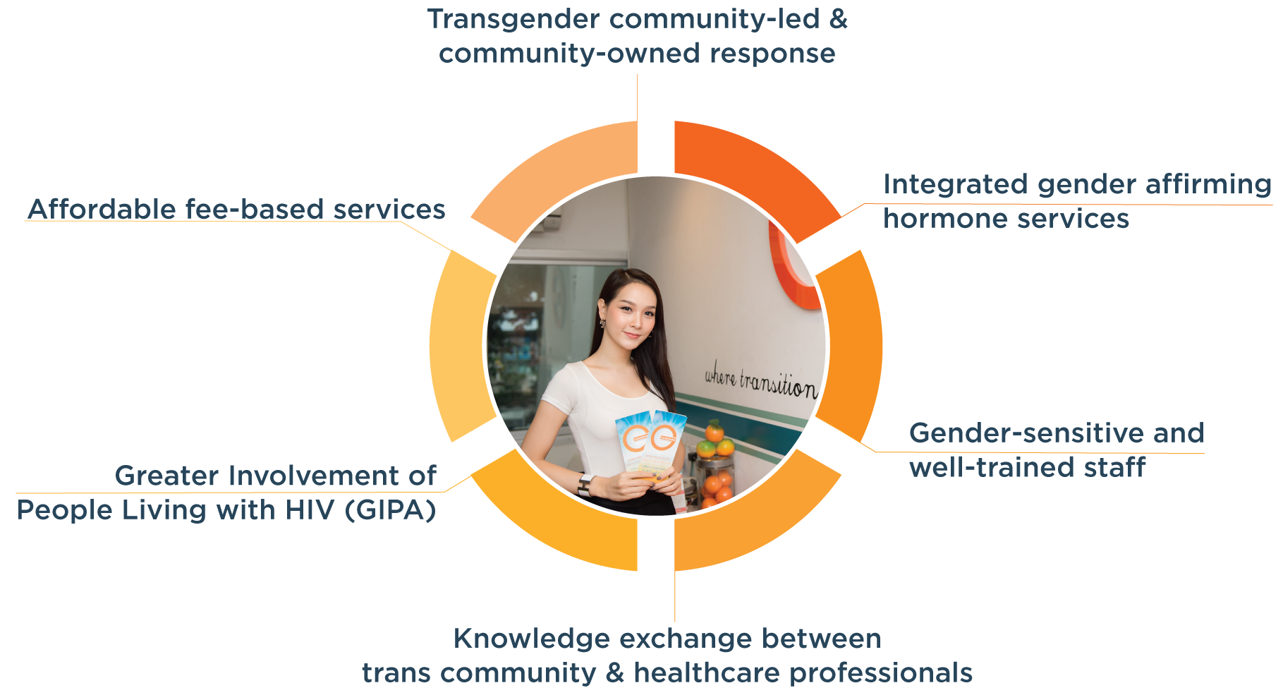
Keys to Success

Slide 17
Acknowledgements
Professor Emeritus Dr. Praphan Phanuphak
Dr. Nittaya Phanuphak
Dr. Frits van Griensven
TANGERINE, PREVENTION, Anonymous Clinic Staff
U.S. President’s Emergency Plan for AIDS Relief (PEPFAR)
United States Agency for International Development (USAID) Regional Development Mission for Asia (RDMA)
LINKAGES Thailand/ FHI 360
Transgender Communities

